Slide 1
Audio to MIDI converter with Synthesizer.
Murtaza Dhuliawala
(1004024)
Sanjay Khatwani
(1004043)
Hirak Modi
(1004054)
Project Guide:
Dr. Archana B. Patankar
Group No: 10

Slide 2
Domain
Digital Signal Processing
Mathematical manipulation of an information signal to modify or improve it in some way.
Frequency Domain Analysis.
Music Information Retrieval
Interdisciplinary science of retrieving information from music.
Melody Extraction.

Slide 3
Problem definition
To create a system that allows users to play any musical instrument without actually having to learn how to play it.
Provide musicians with a tool that would reduce the overhead of learning more and more instruments or searching for artists who could play for them in the making of any composition.
The system first generates a MIDI file from the input audio. MIDI files have a very small size.
MIDI file can be given to a synthesizer or the sound generating module using sound fonts which produces the sound of the desired tone independent of the acoustic instrument on which the music piece was played originally.

Slide 4
Motivation
The motivation is to give composers and musicians more time to be creative and artistic.
A guitarist can play notes on the guitar and get the sound of a piano as a part of his or her composition.
This flexibility that a system of this sort would provide the musicians has been the biggest motivation for the project team.

Slide 5
Scope of the project
The Audio to MIDI converter with synthesizer system has a Graphical User Interface to provide a convenient way to operate the entire system.
Options to first either select a .wav file or record a .wav file.
Monophonic function or polyphonic function for note detection as per the kind of file chosen.
Generate a MIDI sequence of the input file, generate a sound from the synthesizer using the MIDI file generated or get sound of a particular instrument with the use of soundfonts.

Slide 6
Design
Audio Input
Time Domain Noise Reduction
Framing and Windowing
FFT based Power Spectrum
Note Transcription (Peak Detection)
Note Equalization
MIDI File Generation
Sound using Sound Font
Sound Generation
Additive/FM Synthesizer

Slide 7
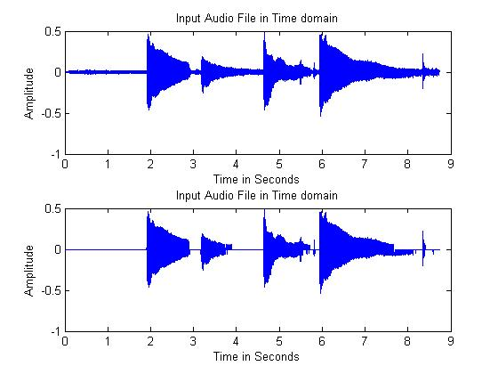
Implementation
Step 1: Take the input.
Select file
Record audio
Step 2: Time domain noise reduction.
Hard clipping

Slide 8
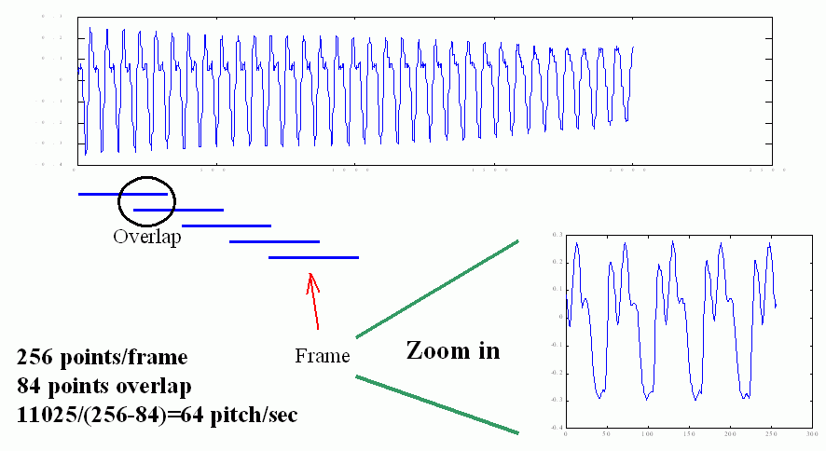
Implementation (Continued)
Step 3: Framing and Windowing
Frame size=2048 samples
Overlap=512 samples
Hanning window
Step 4: Padding Audio

Slide 9
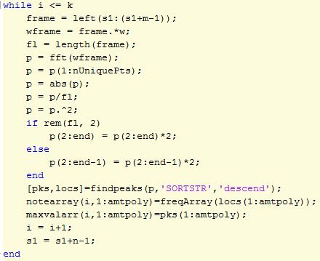
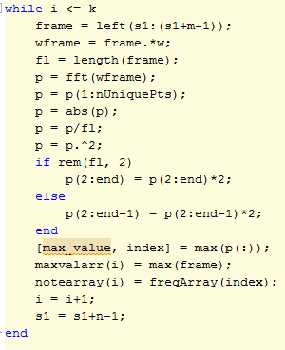
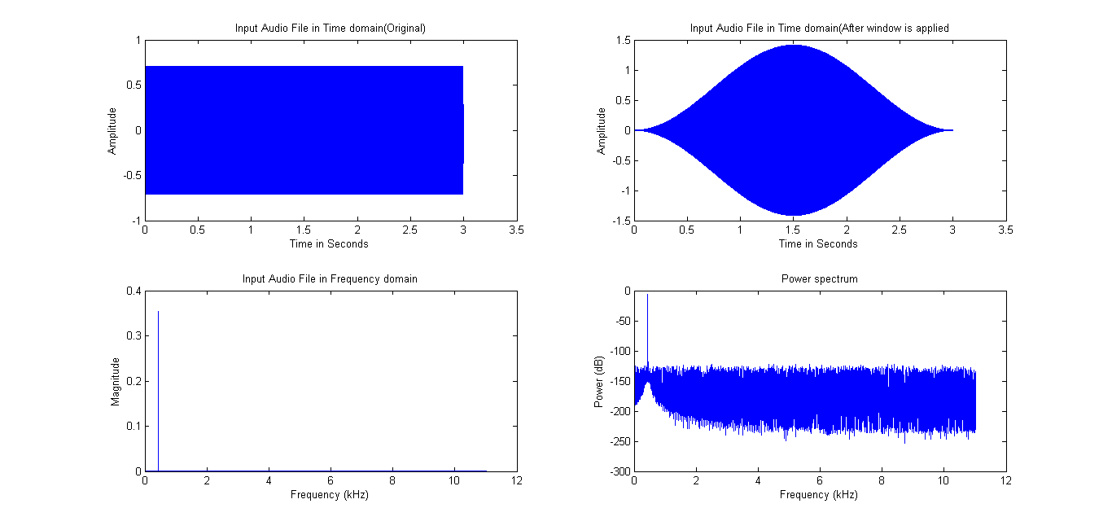
Implementation (Continued)
Step 4: Music transcription (Detect monophonic/polyphonic notes)

Slide 10
Implementation (Continued)
Step 5: Equalize notes.
The user provides a threshold for the number of frames. Now, if a particular note is found to persist for a duration less than or equal to this threshold, it is removed and the previous note is extending for that duration.
At times, the harmonics are dominant compared to the original notes played. It checks for such a situation depending on the octave of the previous and the next notes. Thus, an equalization is performed.
After notes are shifted or combined with the previous notes, they still continue to be separate in the MIDI sequence. So a proper merger of these messages is performed in this module.

Slide 11
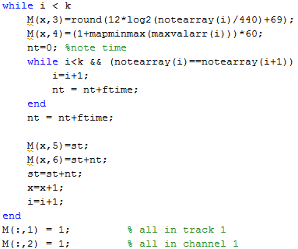

Implementation (Continued)
Step 6: Generate MIDI File.

Slide 12
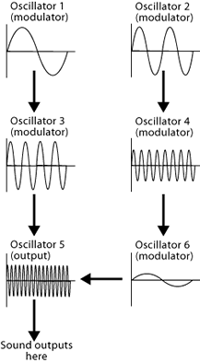
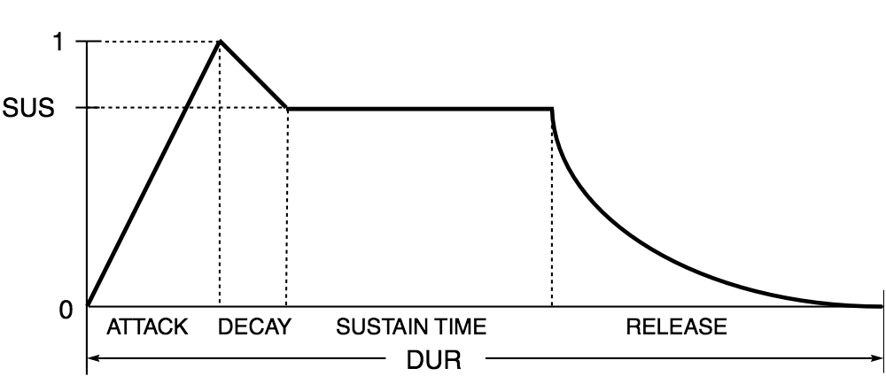
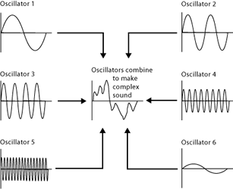
Implementation (Continued)
Step 7: Synthesizer
Additive Synthesizer
Adding output of different waves
Frequency Modulation (FM) Synthesizer
One waveform is modulated according to another waveform.
ADSR Envelope

Slide 13
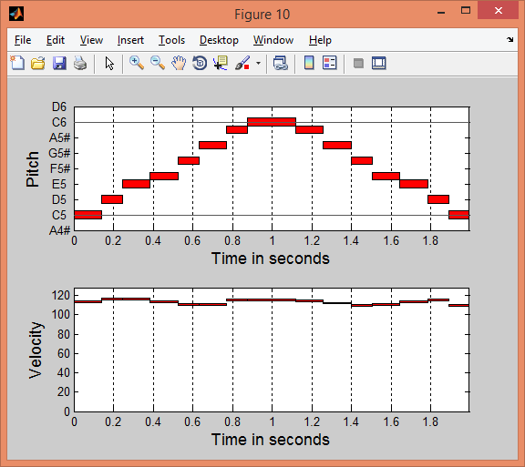
Implementation (Continued)
Step 8: Display piano roll.
Piano roll shows a plot of the MIDI notes versus the time axis.
Velocity Information.
Musician can get idea of transcribed notes.

Slide 14
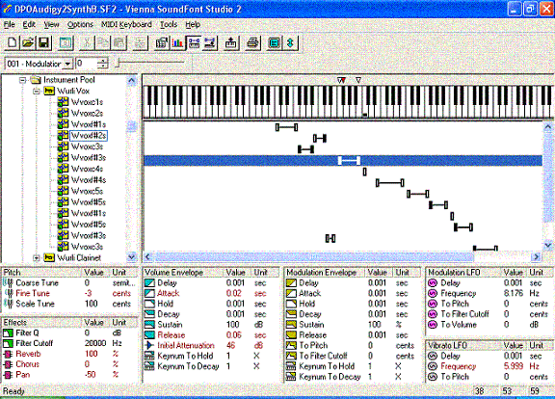
Implementation (Continued)
Step 9: Generate sound from sound fonts
Implementation of sample-based synthesis
SoundFont bank contains base samples in PCM format.
In this system we have provided option for following three sound fonts:
Violin
Electric guitar
piano

Slide 15
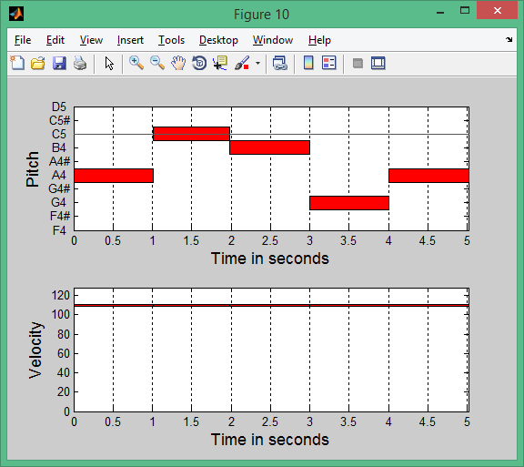
Monophonic Testing

Slide 16
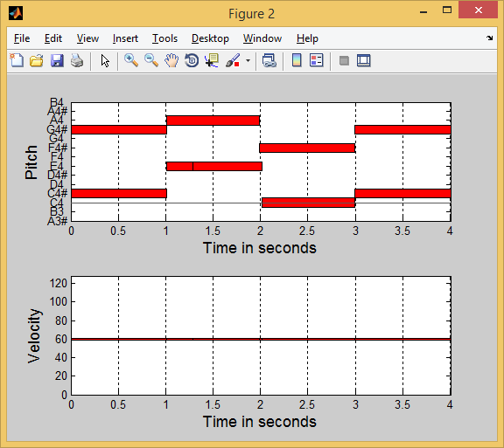
Polyphonic Testing

Slide 17
Testing Results
Test Case | Description | No. of Notes Present | No. of Correct Notes Detected | Accuracy
Mono-1 | Synthetic Sine Wave | 5 | 5 | 100%
Mono-2 | Acoustic Guitar | 4 | 4 | 100%
Mono-3 | Electric Guitar | 16 | 15 | 93.75%
Poly-1 | Piano (amount of polyphony: 2) | 8 | 7 | 87.5%
Poly-2 | Piano (amount of polyphony: 3) | 9 | 7 | 77.78%

Slide 18
Conclusion
Satisfactory output for Monophonic and Polyphonic input with polyphony < 4.
With increase in amount of the polyphony, the efficiency reduces.
Dominant Harmonics and Note Equalization.
Synthesizer provides number of options to create various sounds.
SoundFonts provide sounds of various Acoustic and Electric instruments.

Slide 19
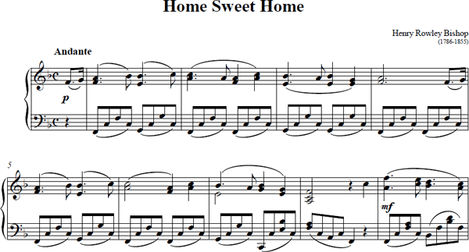
Further Work
Harmonics elimination in the monophonic transcription using Place Pitch Theory.
Note Masking for Polyphonic Music
Note onset detection
Musical Score Generation
Recognition of Indian Classical Ragas and Western Music.

Slide 20
References
[1] A. Taylan Cemgil, Hilbert J. Kappen and David Barber, “A Generative Model for Music Transcription,” IEEE Transactions on Audio, Speech, and Language Processing, Vol. 14, No. 2, March 2006, pp. 679-694.
[2] Say Wei Foo, Wei Thai Lee, “Recognition of piano notes with the aid of FRM filters,” First International Symposium on Control, Communications and Signal Processing, 2004, pp. 409 - 413.
[3] Dimitrios Fragoulis, Constantin Papaodysseus, Mihalis Exarhos, George Roussopoulos, Thanasis Panagopoulos, and Dimitrios Kamarotos, “Automated Classification of Piano–Guitar Notes,” IEEE Transactions on Audio, Speech, and Language Processing, Vol. 14, No. 3, May 2006, pp. 1040-1050.
[4] Ronan Kelly, “Automatic Transcription of Polyphonic Music Using A Note Masking Technique,” Masters of Engineering, University of Limerick, March 2010.

Slide 21
Thank You!

